Slide 1


8
Advanced
Collections
C# Programming: From Problem Analysis to Program Design
3rd Edition

Slide 2
Chapter Outline
Multidimensional Array
String Class
ArrayList Class

Slide 3
1. Multidimensional Array
Arrays can be;
One-dimensional
Two-dimensional
Multidimensional
Two-dimensional and multidimensional arrays follow same guidelines as one-dimensional

Slide 4
Two-Dimensional Array
Two kinds of two-dimensional arrays
Rectangular
Visualized as a table divided into rows and columns
Jagged or ragged

Slide 5
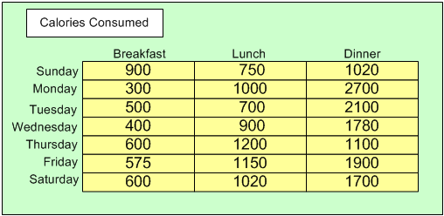
Rectangular Array

Slide 6
Rectangular Array
Rectangular array
Declaration format
<type> [ , ] identifier =
new <type> [<row-size>, <column-size>];
Example (create a 7x3 matrix)
int [ , ] calories = new int[7, 3];

Slide 7
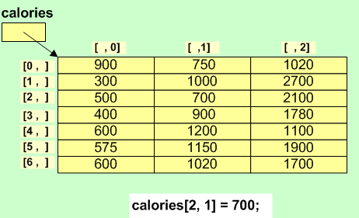
Rectangular Array
calories references address of calories[0,0]

Slide 8
Jagged Array
Jagged arrays are also called ‘arrays of arrays’
Example
int[ ] [ ] anArray = new int[4] [ ];
anArray [0] = new int[ ] {100, 200};
anArray [1] = new int[ ] {11, 22, 37};
anArray [2] = new int[ ] {16, 72, 83, 99, 106};
anArray [3] = new int[ ] {1, 2, 3, 4};

Slide 9
Multidimensional Array
Format for creating three-dimensional array
<type> [ , , ] identifier =
new <type> [<dim1-size>, <dim2-size>,<dim3-size>];
Example (rectangular)
int [ , , ] calories = new int [4 ,7 ,3];
(4 week; 7 days; 3 meals)
Allocates storage for 84 elements

Slide 10
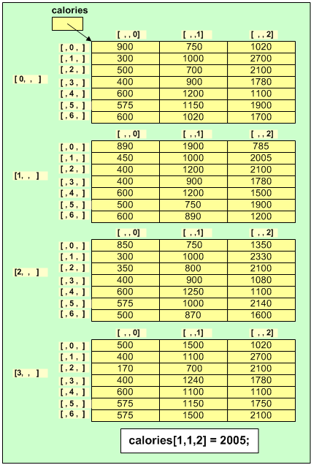
Multidimensional Array
Upper bounds on the indexes are
3, 6, 2

Slide 11
2. String Class
The String class in C# has many methods
Examples:
ToLower( )
ToUpper( )
Substring( int )
Substring( int, int )
IndexOf(string)
IndexOf( string, int )
LastIndexOf(string )
LastIndexOf(string, int )
Notes:
Substring (int) – retrieves a substring from this instance. The substring starts at specified character position and continues to the end of the string.
Substring (int, int) - retrieves a substring from this instance. The substring starts at specified character position and has a specified length.
IndexOf(string) - Reports the zero-based index of the first occurrence of the specified string in this instance.
IndexOf(string, int) - Reports the zero-based index of the first occurrence of the specified string in this instance. The search starts at a specified character position.

Slide 12
String Class Methods
Example 1:
string s1 = "ABC";
string s2 = s1.ToLower();
Console.WriteLine(s2);
Output:
abc

Slide 13
String Class Methods
Example 2:
string s3 = "abc";
string s4 = s3.ToUpper();
Console.WriteLine(s4);
Output:
ABC

Slide 14
String Class Methods
Example 3:
string s5 = "abcde";
string s6 = s5.Substring(2);
Console.WriteLine(s6);
string s7 = s5.Substring(2,1);
Console.WriteLine(s7);
Output:
cde
c
Notes:
The first integer argument is always the start index. The second, optional argument is the desired length—not the end index.Substring parameters Substring(0, 3) Returns substring of first 3 chars.
Substring(3, 3) Returns substring of second 3 chars.
Substring(6) Returns substring of all chars after first 6.

Slide 15
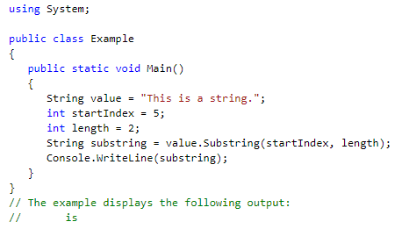

Slide 16
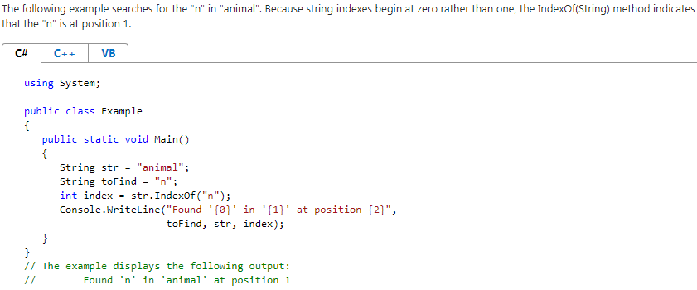

Slide 17
String Class Methods
Example 4:
string s8 = "Happy Birthday To You";
int pos1 = s8.IndexOf(" ");
Console.WriteLine("First space: {0}", pos1);
int pos2 = s8.IndexOf(" ", pos1 + 1);
Console.WriteLine("Next space: {0}", pos2);
int pos3 = s8.LastIndexOf(" ");
Console.WriteLine("Last space: {0}", pos3);
Output:
First space: 5
Next space: 14
Last space: 17
Notes:
a string method, returns the first index of a letter in a string. It can also find a substring. It is often used in looping constructs.
//arg1: string to search for, //arg2: search starting position

Slide 18
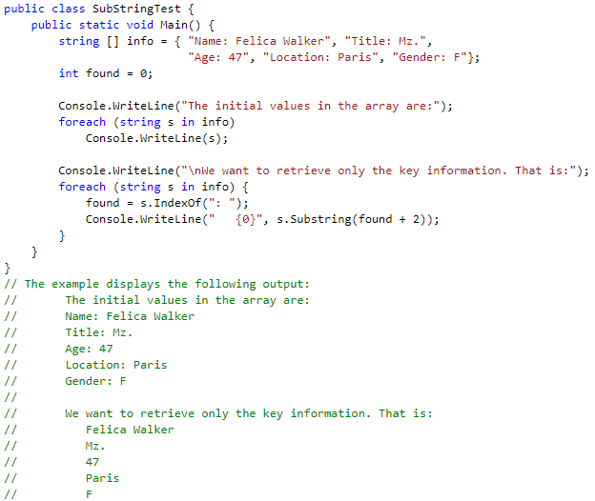

Slide 19
using System;
class Program
{
static void Main ( )
{
string s = "I have a cat";
int i = 0;
while(( i = s.IndexOf ('a', i)) != -1)
{
Console.WriteLine (s.substring (i));
i++;
}
}
}
Notes:
ave a cat
a cat
at

Slide 20
Ex: IndexOf(char)
using System;
class Program
{
static void Main ( )
{
const string s = "I have a dog";
int i = s.IndexOf ('d');
string d = s.substring (i);
Console.WriteLine (d);
}
}

Slide 21
Characters in Strings
Example:
string str = "hello";
for (int i = 0; i < str.Length; i++)
Console.Write("{0} ", str[i]);
Console.WriteLine();
for (int i = str.Length-1; i >= 0; i--)
Console.Write("{0} ", str[i]);
Output:
h e l l o
o l l e h

Slide 22
Comparing Strings
Example:
string s1 = "hello";
string s2 = "hello";
if (s1 == s2) Console.WriteLine("Equal");
if (s1.Equals(s2))
Console.WriteLine("Equal");
Output:
Equal
Equal

Slide 23
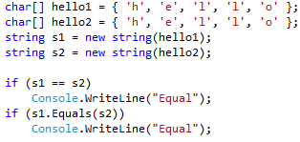

Slide 24
Equality of Objects
Example 1:
Account a1 = new Account(100);
Account a2 = new Account(100);
if (a1 == a2)
Console.WriteLine("Equal");
else
Console.WriteLine("Not Equal");
Output:
Not Equal

Slide 25
Equality of Objects
Example 2:
Account a1 = new Account(100);
Account a2 = a1;
if (a1 == a2)
Console.WriteLine("Equal");
else
Console.WriteLine("Not Equal");
Output:
Equal

Slide 26
3. ArrayList Class
Limitations of traditional array
Cannot change the size or length of an array after it is created
ArrayList class facilitates creating array-like structure, BUT it can dynamically increase or decrease in length
Includes large number of predefined methods

Slide 27
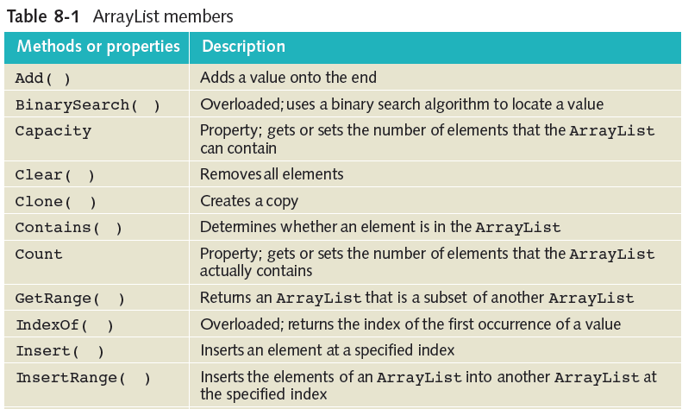
ArrayList Class (continued)

Slide 28
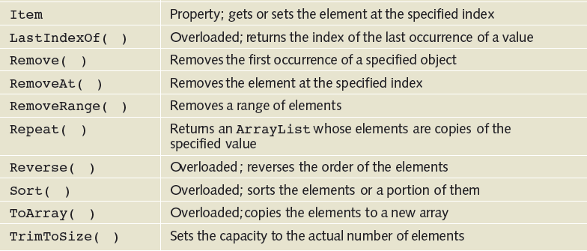
ArrayList Class (continued)

Slide 29
Array vs ArrayList Example
class Car
{
private string regNumber;
public string RegNumber
{
get { return regNumber; }
}
public Car(string number)
{
regNumber = number;
}
}

Slide 30
Array vs ArrayList Example
using System;
class CarArray // using array
{
static void Main()
{
Car[] cars = new Car[3];
cars[0] = new Car("ABC1234");
cars[1] = new Car("ABC5678");
cars[2] = new Car("ABC9999");
for (int i = 0; i < cars.Length; i++)
{
Car c = cars[i];
Console.WriteLine(c.RegNumber);
}
}

Slide 31
Array vs ArrayList Example
using System;
using System.Collections;
class CarArrayList // using ArrayList class
{
static void Main()
{
ArrayList carList = new ArrayList();
carList.Add(new Car("ABC1234"));
carList.Add(new Car("ABC5678"));
carList.Add(new Car("ABC9999"));
for (int i = 0; i < carList.Count; i++)
{
Car c = (Car)carList[i];
Console.WriteLine(c.RegNumber);
}
}
}

Slide 32
ArrayList Example
using System;
using System.Collections;
class ArrayListExample
{
static void Main()
{
ArrayList anArray = new ArrayList();
anArray.Add(“Today is my lucky day”);
anArray.Add(“Enjoy it”);
anArray.Add(“OK”);
anArray.Add(“You may not get a second chance”);
Console.WriteLine(“Count of elements in array{0}”,
anArray.Count);
anArray.RemoveAt(2);
DisplayContents (anArray);
}
public static void DisplayContents (ArrayList ar)
{
for (int i=0; i<ar.Count; i++)
Console.WriteLine(ar[i]);
}
}

